Slide 1

Power vs Throughput vs Scalability: Apache Spark/Hadoop on Raspberry Pi Cluster + ThunderX server
Anna Marusarz Ji Tin Justin Li

Slide 2
Abstract
Objectives:
Feasibility analysis of deploying distributed software on light-weight compute nodes
Performance comparison with powerful server
Workload Types:
Hadoop: WordCount
Spark: K-Means
Target Performance Metrics:
(Disk) Throughput, cluster scalability, data to power ratio
Notes:
DFS - backbone for big data and machine learning fields
Typical setups uses dedicated server machines:
(Storage nodes - huge hdds for cold storage, ssd/nvmes for hot storage)
(Compute nodes - Abundant memory and compute resources)
-> which means high initial costs.
Explore alternative solution - light weight, “computer on a chip” raspberry pis.
On the surface, the pis provides some benefits: low power, highly scalable. Easy to build a homogenous cluster.
Big questions - Are the pis capable and a viable alternative? Are they comparable to typical server solutions?
Compare with a modern enterprise server machine, thunderx on mystic cluster.

Slide 3
Proposed Work
Set up cluster + OS
Install NFS server and clients
Set up abilities to control all nodes from single server
SSH, Java 8, python, etc
Install + configure Hadoop and Apache Spark
Testing disk performance with IOzone
Measuring power abilities
Decide on benchmarks
Monitor resource usage during experiments
Run code + configure Ideal testbed
Data generation and automate experiments
Tune Spark + Hadoop configs for optimum performance
Run benchmarks
Notes:
Set up nfs on the machines
Set up ability to control all pis/dells from the server
Install and Configure Apache Spark and Hadoop
Configure appropriate parameters to make for ideal testbed
Set up ability to measure power and resource usage
Use Iozone to test disk performance
Use scripting to automate experiments and create test data

Slide 4


Hardware Specifications
Raspberry Pi vs ThunderX
Specs | Raspberry Pi | Cavium ThunderX
Model | Raspberry Pi 4 Model B Rev 1.1 (2019) | ThunderX 88XX
Processor | Arm Cortex-A72 | 64bit Armv8
Speed | Max 1500MHz Min 600MHz | Maz 2GHz
Cores | 4 | 96
RAM | 2GB | 64GB
OS | Ubuntu 19.10 (Eoan Ermine) | Ubuntu 18.04.4 LTS (Bionic Beaver)
Notes:
lscpu

Slide 5


Hadoop/Spark Configurations
Raspberry Pi | Cavium ThunderX
16 | 1
48GB (Total = 768GB) | 384 GB
512 MB | 768 MB
128 MB | 768 MB
1536 MB | 49152 MB (48GB)
4 (Total = 64) | 64
fully distributed | pseudo distributed
Available Workers
Configured Disk Space
Yarn MapReduce Resource
Yarn Min Allocation
Yarn Max Allocation
Yarn CPU V-Cores
Mode
Notes:
yarn.nodemanager.resource.memory-mb=amount of memory yarn can utilize on the node. should be less than the the amount of ram. 1536 was chosen based on it being less than 2gb and leaving some ram for the os,etc
yarn.scheduler.maximum-allocation-mb=memory available for the container
allocate memory to containers in increments of the min allocations and not exceed the max allocation.
yarn.app.mapreduce.am.resource.mb: This property specify criteria to select resource for particular job. Here is given 512MB Means any nodemanager which has equal or more memory available will get selected for executing job.

Slide 6
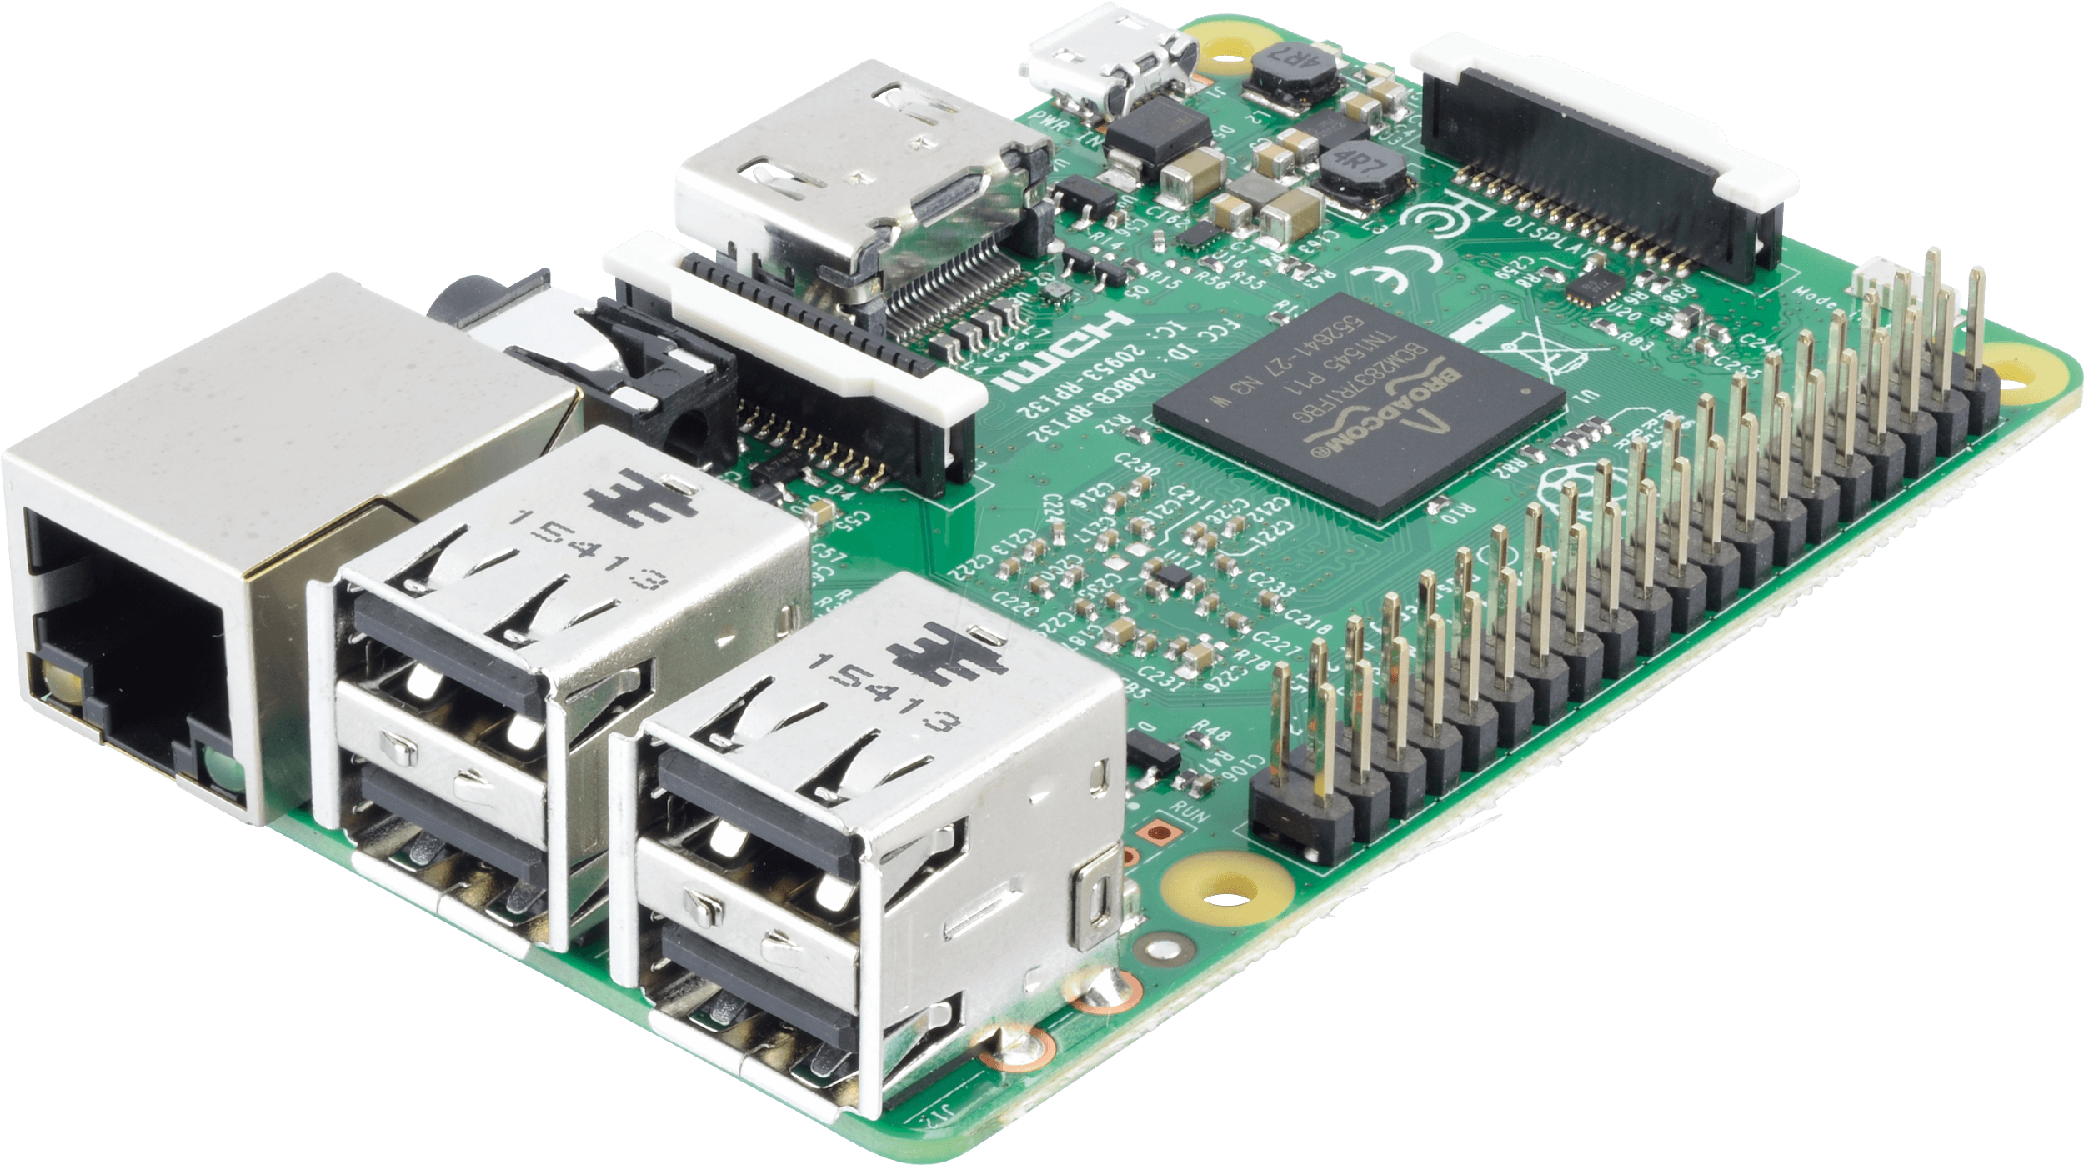
Raspberry Pi Cluster Evaluation

Slide 7
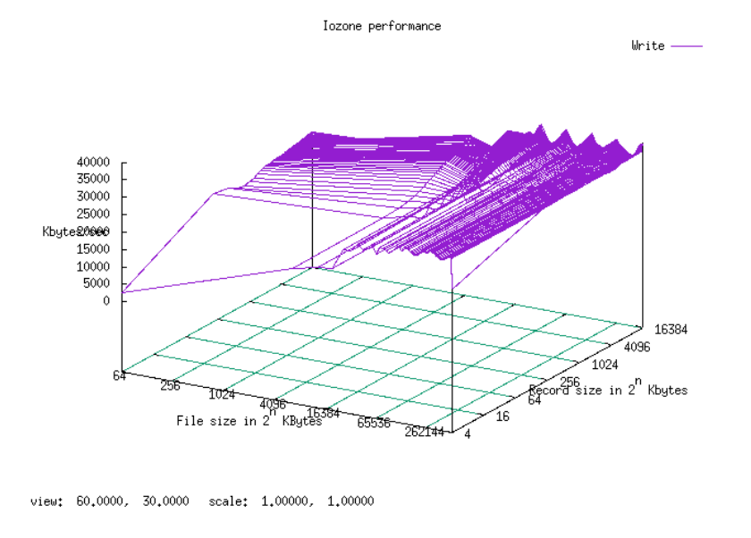
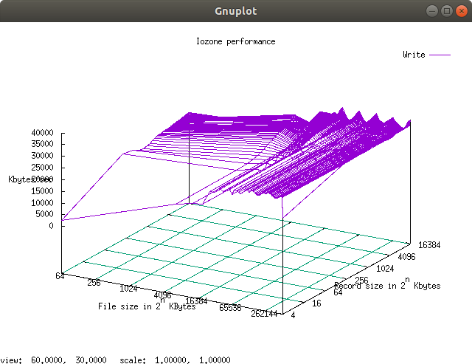
Disk performance on Individual Pis
SanDisk Extreme 90MB/s U3 64GB
Read ~35-40MB/s
Write ~30-35MB/s
16MB+ file sizes
512kB+ record size
Notes:
Proceed with care: Hadoop and Spark are optimized for HDDs and SSDs, not SD cards. Find out how it behaves compared to average hdds and ssds. Avoid “dark spots” on disk accesses and configs for hdfs and spark.

Slide 8
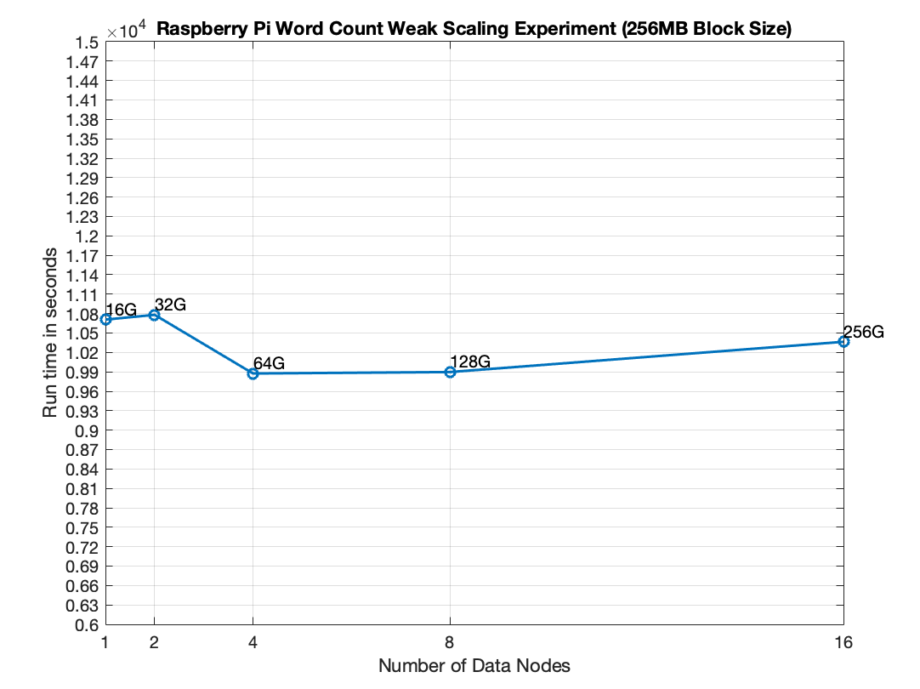
Raspberry Pi Word Count Weak Scaling Experiment
Experiment varied by using different HDFS block size. Optimal size is shown (256MB)
Processing Analysis:
For a 16 data node scale, 256GB of data is processed in 10364s
25.3 MB/s

Slide 9
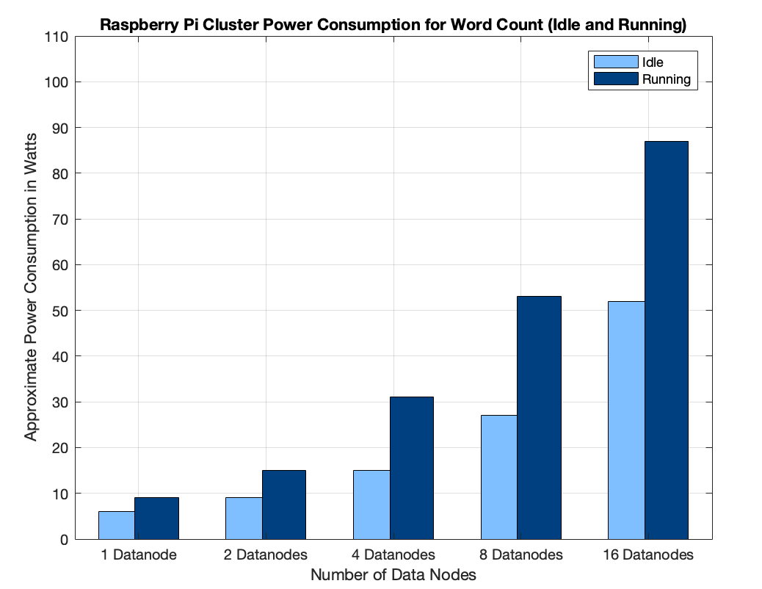
Raspberry Pi Word Count Average Power Measurement
As expected, power increased as the CPU idle time decreased
CPU is active ~98-99
Power Analysis:
25.3 MB/s at 87W, thus
87/25.3 3.44 W per 1MB/s
Notes:
How: Pis does not come with power monitoring tools. s/h
(external ups is use to monitor the total power consumption of the entire cluster. Cluster(18 nodes) idle wattage = 55W)
(idle per pi 3W.)
Sources say up to 15W can be drawn per pi. We are only seeing a rise to up to 8W per pi.
(Granularity of ups is 5W.)
Power scales pretty well. The cpu is fully utilized when running hadoop wc.
16 nodes:..
3.44 J/MB

Slide 10
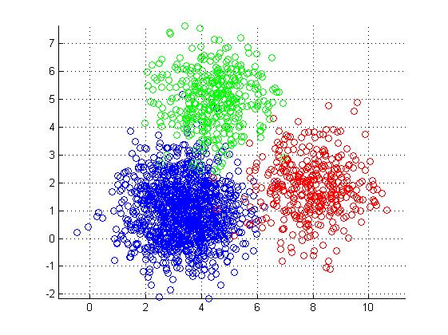
Spark K-Means on Raspberry Pi
K-Means Clustering Algorithm with K=5 clusters and 20 iterations
3D points are generated by script ranging from -10 to 10 w/ 3 decimal places.
Yarn node manager memory + max allocation increased to 1.8GB to fit more than one container per node + make 1 data node experiment possible
Executor Memory: 465MB executor-memory + 384MB overhead 849MB
1 Application Master/Experiment: 512MB driver-memory + 384MB overhead 896MB
Notes:
driver memory for cluster mode.

Slide 11
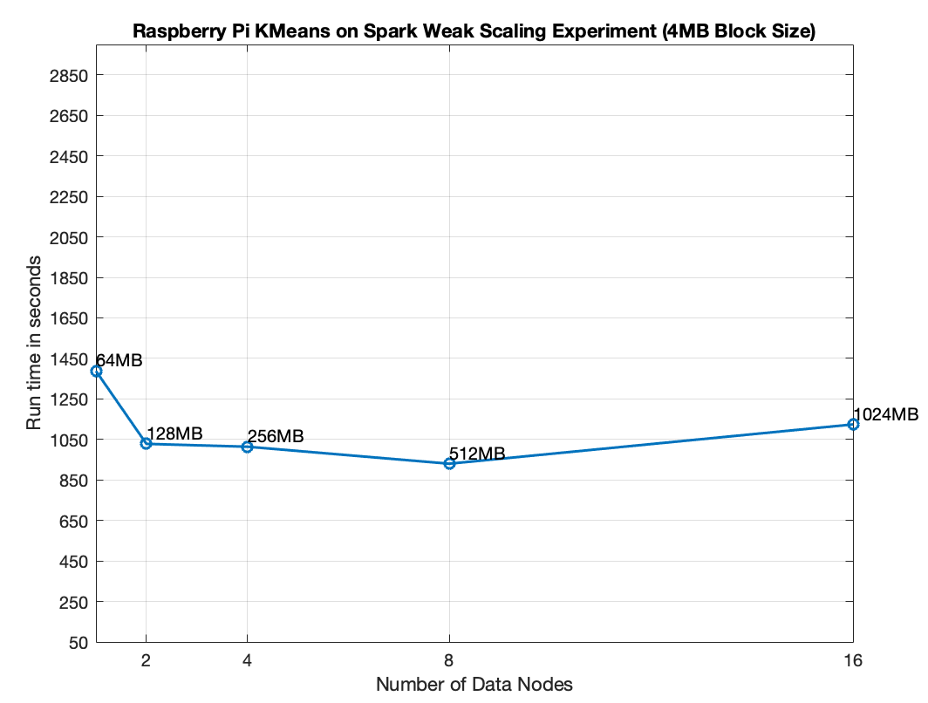
Raspberry Pi K-Means on Spark Weak Scaling Experiment
Data Nodes | Executors | AM
1 | 1 | 1
2 | 3 | 1
4 | 7 | 1
8 | 15 | 1
16 | 31 | 1
Notes:
Spark achieves greater performance in iterative algorithms.
Tune Spark to make use of available cluster resources

Slide 12
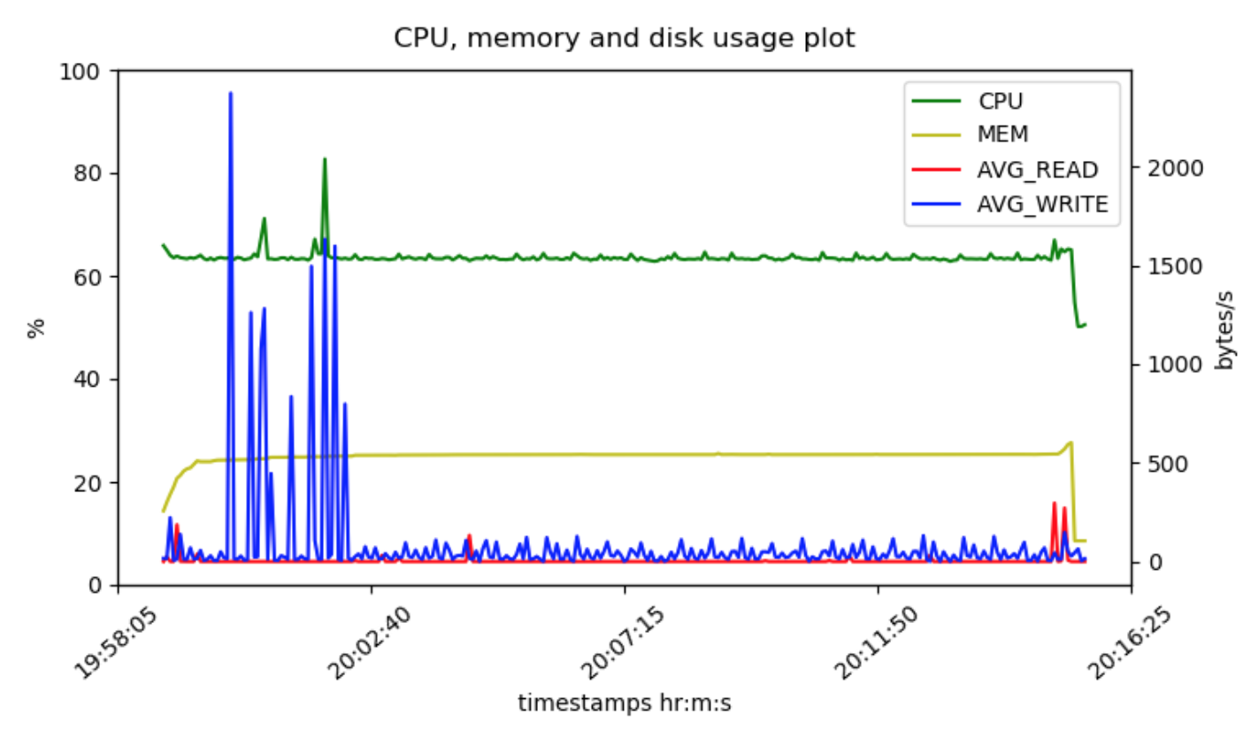
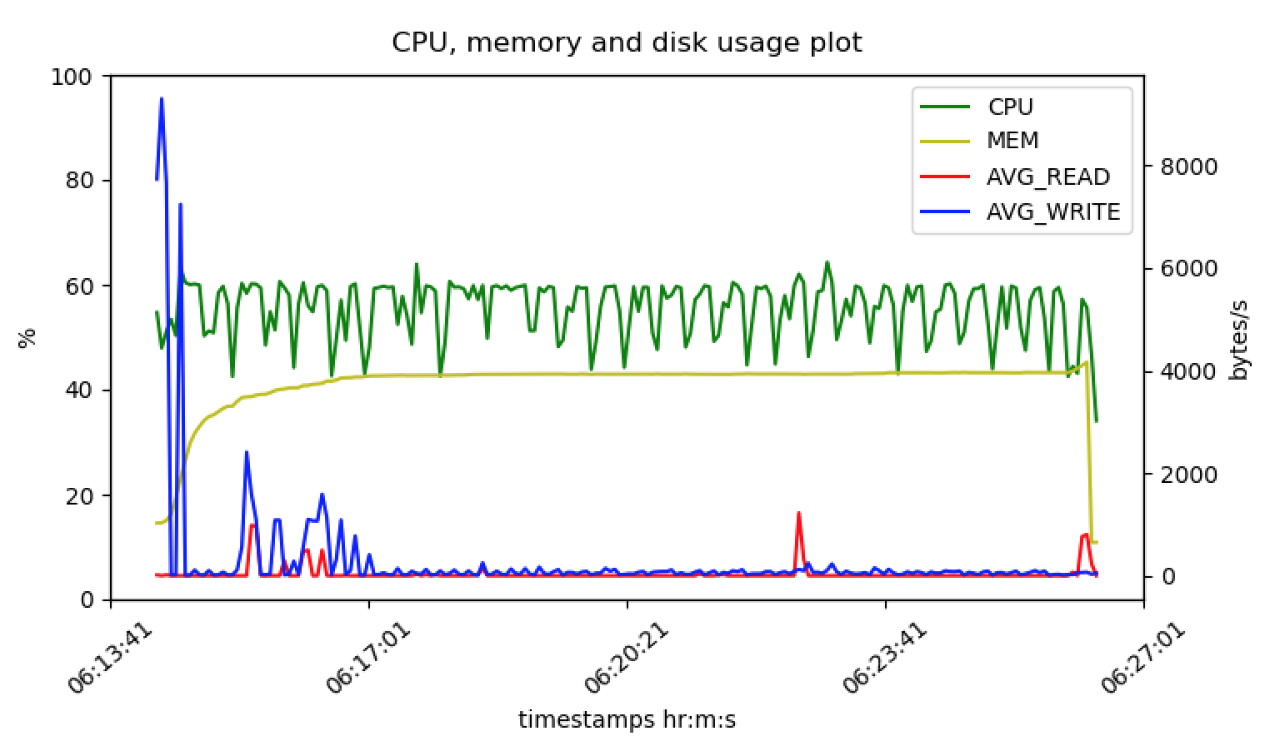
Resource Usage Plots for Pi K-Means Experiment
1 Data Node Experiment
2 Data Nodes Experiment
Notes:
Using sar. Monitors whole system resource usage.
Data is averaged at each timestep, taken every 1s.
CPU and MEM are shown in %, and disks usage are in bytes/s.
(How: Scripting tools with pssh pslurp to automate resource logging. Pyplot for display)
Kmeans should be compute heavy. Cores seems to not be fully utilized.

Slide 13
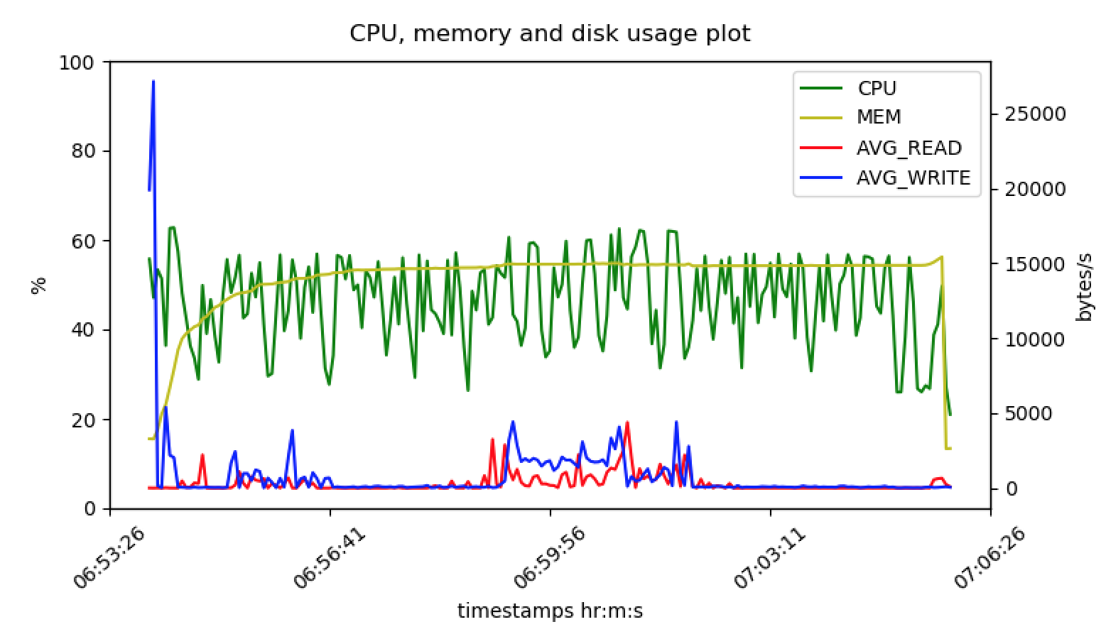
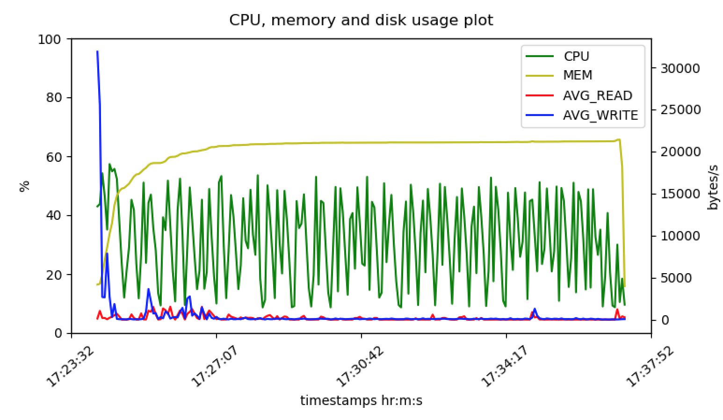
4 Data Node Experiment
8 Data Node Experiment
16 Data Node Experiment
Notes:
Low cpu usage

Slide 14
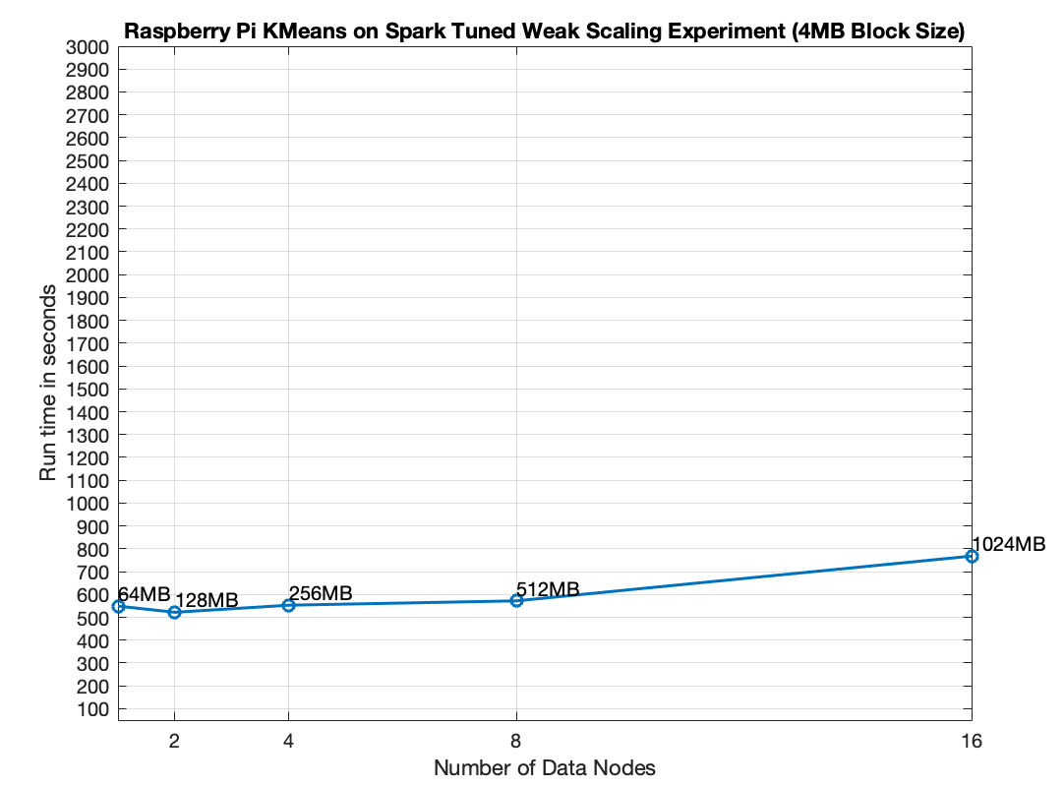
Raspberry Pi K-Means on Spark Tuned Weak Scaling Experiment
Executor-cores was increased to 4 to increase the processing power of Raspberry Pi.
Executor-memory was increased to 512MB
Time taken was cut by half
Processor Analysis: For a 16 data node scale 1024MB of data is processed in 768s, thus 1024MB/768s 1.33Mb/s
Notes:
Spark achieves greater performance in iterative algorithms.
Tune Spark to make use of available cluster resources

Slide 15
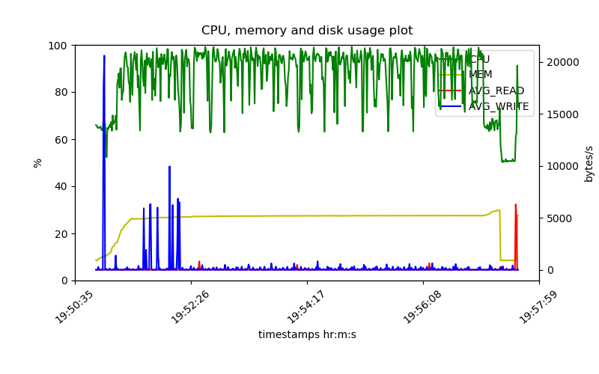
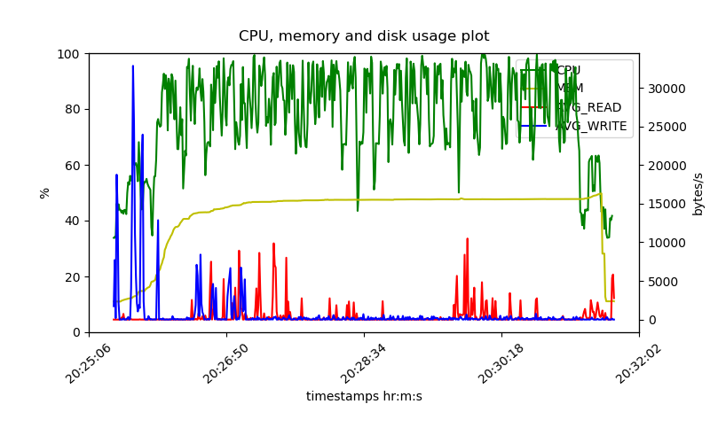
Resource Usage Plots for Tuned Pi K-Means Experiment
1 Data Node Experiment
2 Data Nodes Experiment
Notes:
Left: datanode, 1 node
Right: datanode, 2 nodes

Slide 16
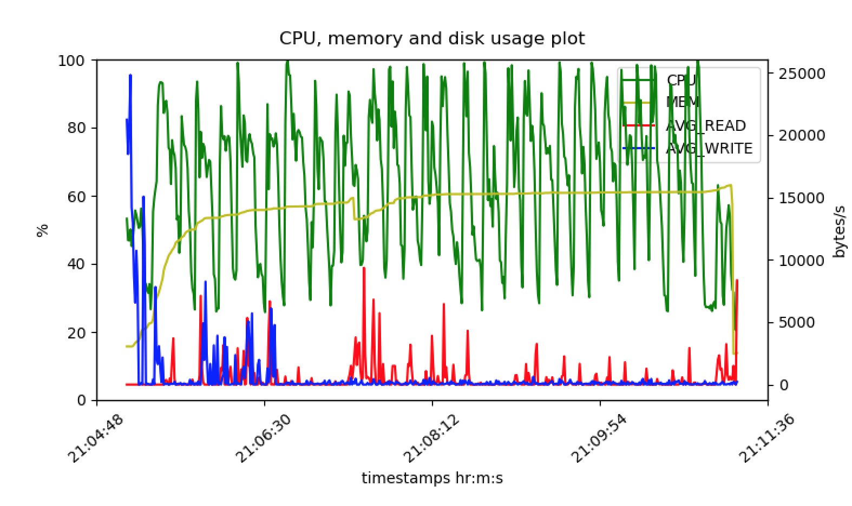
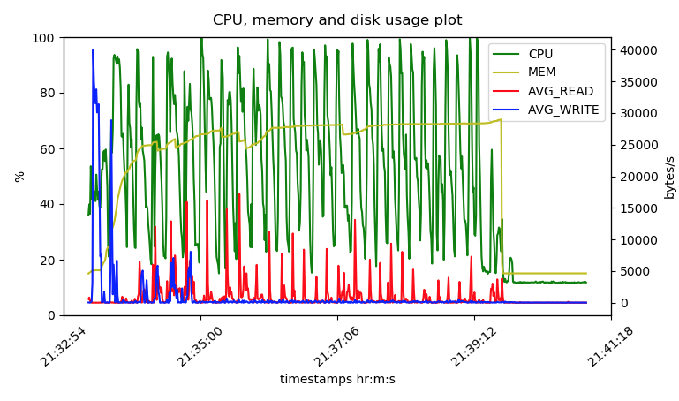
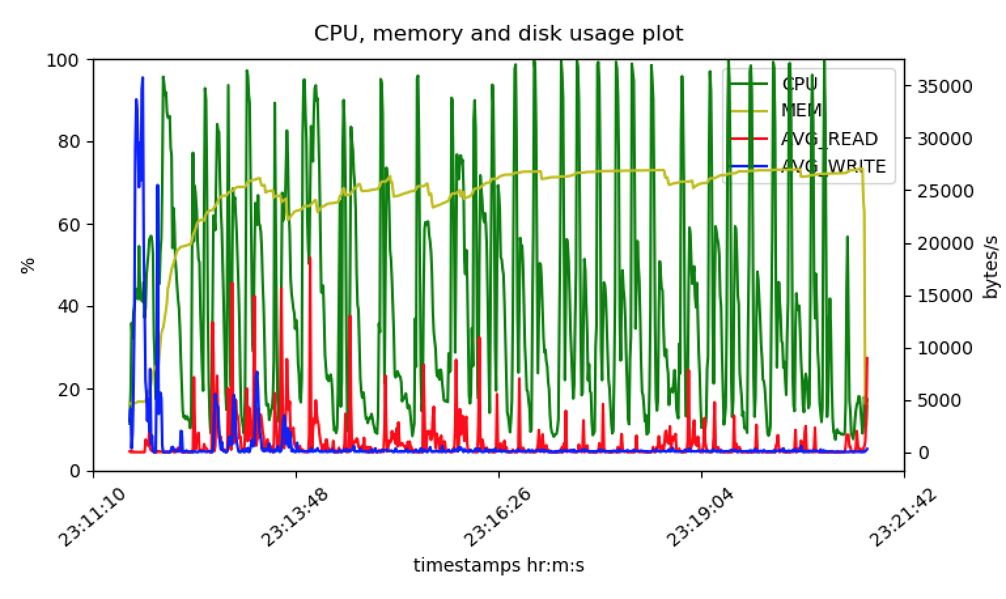
4 Data Node Experiment
8 Data Node Experiment
16 Data Node Experiment
Notes:
“Bursty” cpu usages. This pattern can also be seen when monitoring power.

Slide 17
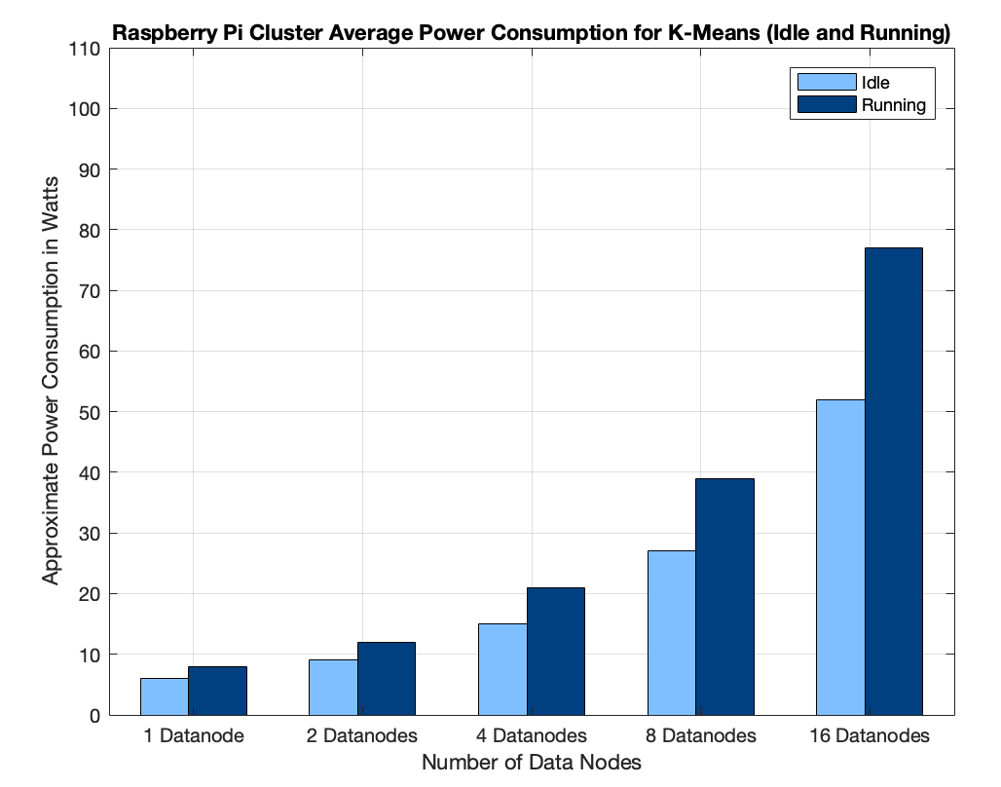
Raspberry Pi K-Means on Spark Tuned Average Power Measurement
Power Analysis: For a 16 data node scale, 1.33 MB/s at an average 77W
Thus, 77W/1.33 57.89 W per 1MB/s
Notes:
Spark achieves greater performance in iterative algorithms.
Tune Spark to make use of available cluster resources

Slide 18
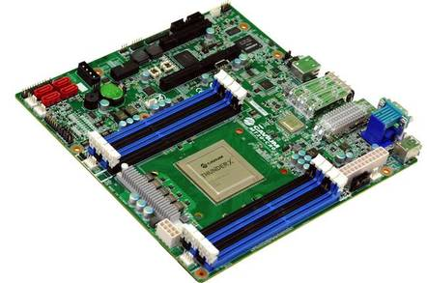
ThunderX
Evaluation

Slide 19
ThunderX Word Count Experiment
Based on the disk space, 128GB workload was decided for the WordCount Experiment
256MB block size as used to keep consistent w/ Pi exp.
64 cores were used + 48 GB of memory to process 128GB of data in 49m 38s (2978s)
Processing Analysis:
128GB is processed in 2978s, thus 128GB/2978 44 MB/s

Slide 20
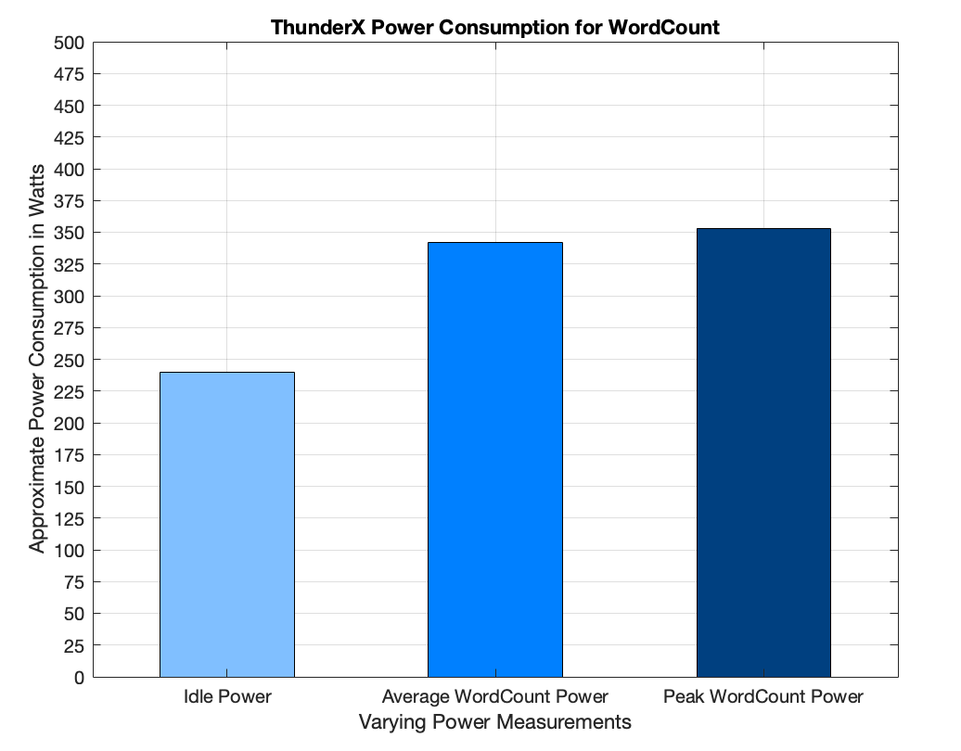
ThunderX Word Count Average Power Measurement
Power rose 100W over Idle measurement
Power Analysis:
44MB/s at 342W, thus
342/44 MB/s 7.77 W per 1MB/s
Notes:
Power measurements taken from the BMC when running word count.
BMC hosts a web server
Baseline/idle wattage is way higher. 55W to 240W

Slide 21
ThunderX Word K-Means Experiment
K-Means Clustering Algorithm with K=5 clusters and 20 iterations
3D points are generated by script ranging from -10 to 10 w/ 3 floating points.
Driver memory: 2g Executor memory: 1g
3072MB was used for the workload
4MB block size as used to keep consistent w/ Pi exp.
Processing Analysis: 3072MB processed in 681 seconds 3072/681 4.5 MB/s

Slide 22
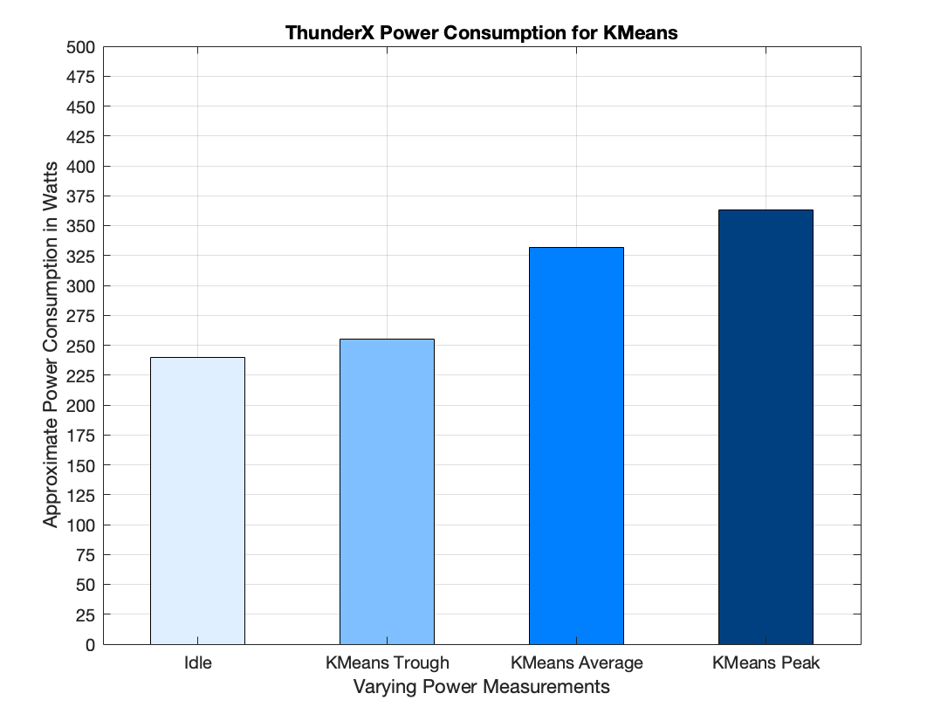
ThunderX Word K-Means Power Measurement
Similar to Pi Kmeans experiment, the power has peaks and troughs throughout the experiment
Power Analysis: 4.5 MB/s in an average 332W, 332/4.5 73.77 W per 1MB/s

Slide 23


Final Comparisons
 | Raspberry Pi Cluster (16 nodes) | Cavium ThunderX Server
Word Count Processing Time | 26 MB/s | 44 MB/s
Word Count Processing Power | 3.44W per 1 MB/s | 7.77 W per 1 MB/s
K-Means Processing Time | 1.33 MB/s | 4.5 MB/s
K-Means Processing Power | 57.89 W per 1MB/s | 73.77 W per 1MB/s
Price Points | $50 * 17 = $850 | (<$6,000)
Fault Tolerance | yes | no
Notes:
Relate back to hardware specs:
Processing Time -
Pi - 4 cores -> 16*4 = 64 cores, peak 1.5GHz
ThunderX - 96 cores, 2GHz
5700
~$6280

Slide 24
Conclusion
Raspberry Pis are compact, cheap, and consume very low power
Easily add more Pis to the cluster “scale out”
Hadoop and Spark work well with the Pis and scale well
The ThunderX, though around twice as fast as the Raspberry Pis, is more expensive and consumes more watts per processing power.
Notes:
Raspberry Pis are compact, cheap + consume low power
Hadoop and Spark works well with Raspberry Pis - highly scalable

